Slide 1


Slide 2

About Us
A French video game publisher.
Multiple popular game franchises
Assassin’s Creed
Far Cry
Watch Dogs

Slide 3
Objective
Create a website that showcases the company and it’s products

Slide 4
GitHub Repository
https://github.com/momokamalz/ubisoft

Slide 5
Requirements
Functional
Non Functional
Browse Games
Purchase Games
Pre-order Games
Report Issues
Report Bugs
Report Players
Display and Promote Games
Home page (Current promotions & Latest games released)
Compatibility with Windows OS, Mac OS and Linux
iOS and Android compatibility.
Latest console browsers

Slide 6
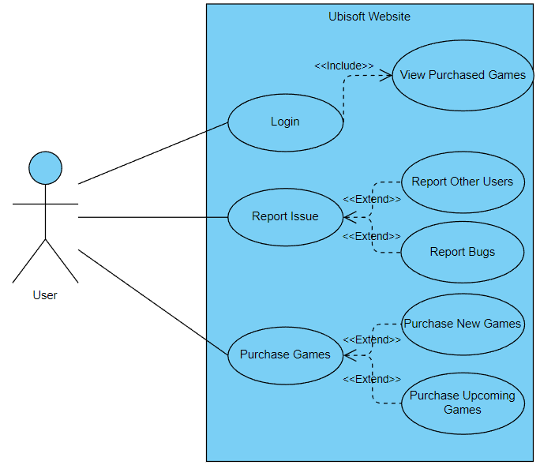
Use Cases
Login Page
View Purchased Games
Contact Us
Report Other Users
Report Bugs
Sign up for newsletter
Purchase Games
Purchase New games
Pre-order Upcoming games

Slide 7
Questions and Answers
Q: What Is The Benchmark For Project Success?
A: The website needs to be functional and with some features implemented
Q: Who Is The Target Audience For The Work?
A: Gamers are the primary target of the system, however it accessible to people who would like to get in touch with Ubisoft as well.

Slide 8
Questions and Answers
Q: What Are Some Potential Barriers?
A: Learning Curve and Starting from little to no prior knowledge.
Q: What Impact Does Our Project Contribute To Our Client?
A: Creating an online platform for users to interact with and gain information about Ubisoft, grants exposure. Further, the ability to easily access games engages users to purchase and invest more time and money into Ubisoft.

Slide 9
Questions?
Vyom Devgan, Mohsin Mohammed, Guneet Singh

